Slide 1
Nano and Graphene technologies for photonics
Airframe R&T – ISROS2016
Marie-Anne De Smet

Slide 2
Contents
Introduction
Typical photonic applications
Recommendations for future

Slide 3
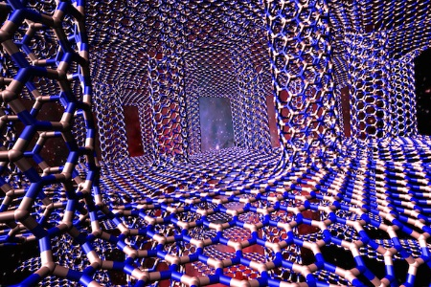
Graphene….
….a dream

Slide 4
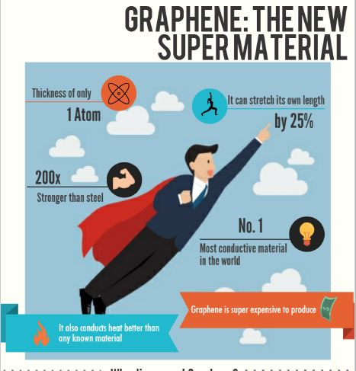
Introduction – Graphene Super Material ….

Slide 5
Introduction – Graphene Super Material ….

Slide 6
Introduction – Graphene Super Material ….

Slide 7
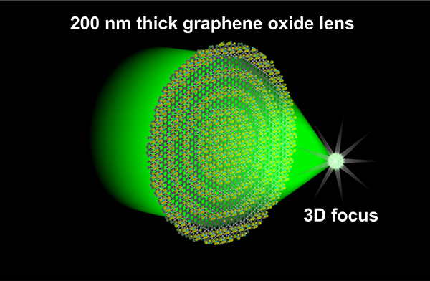
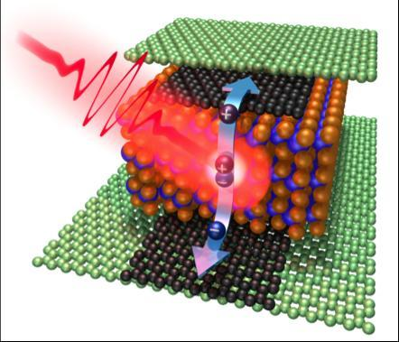
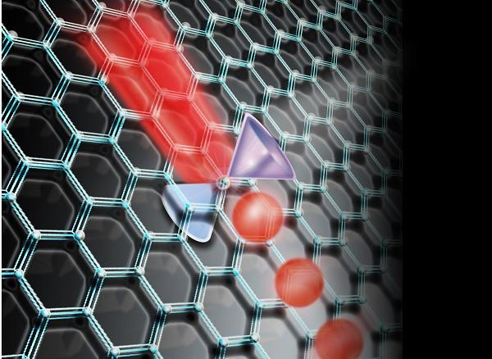
Introduction – Nano and Graphene technologies for photonics
Typical photonics cases
Laser – CMOS
Plasmon - Phototransistors - Photodetectors Modulator…..

Slide 8
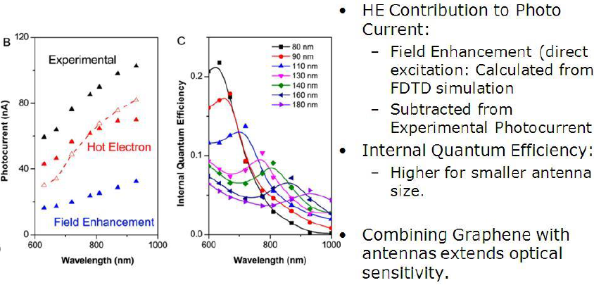
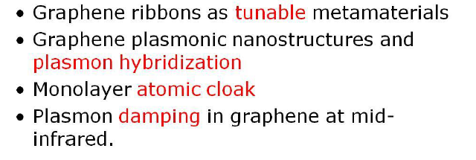
Typical photonic applications - Plasmon

Slide 9
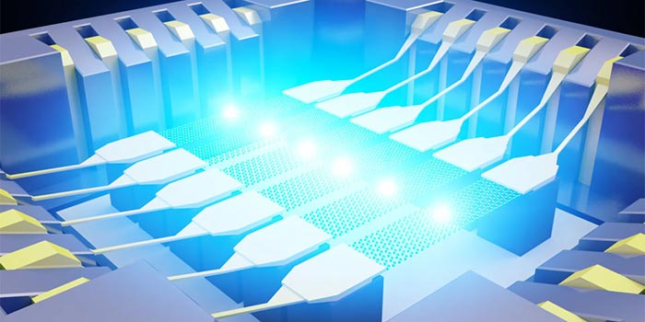
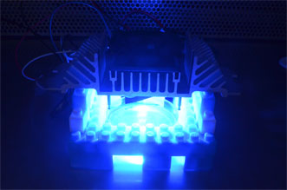
Typical photonic applications –Graphene to Light
IOP Graphene Light bulbe shine
Hexus.net

Slide 10
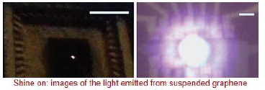
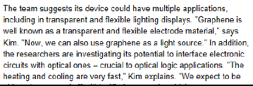
Typical photonic applications - Plasmon
IOP Graphene Light bulbe shine
Hexus.net

Slide 11
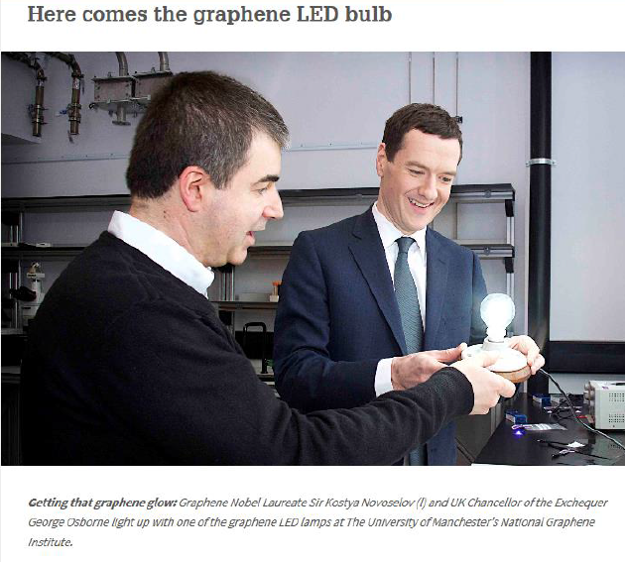
Typical photonic applications - Graphene Lighting

Slide 12
Typical photonic applications - Graphene Lighting

Slide 13
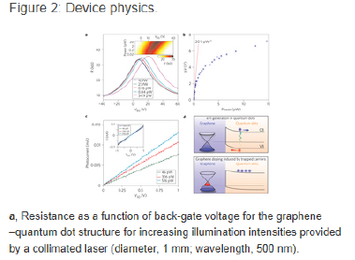
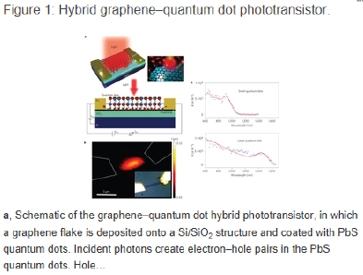
Typical photonic applications - Phototransistors

Slide 14
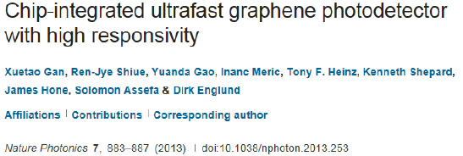
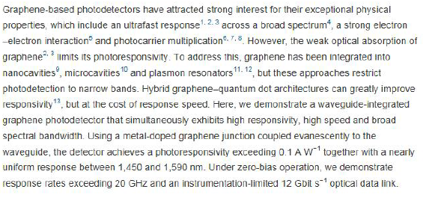
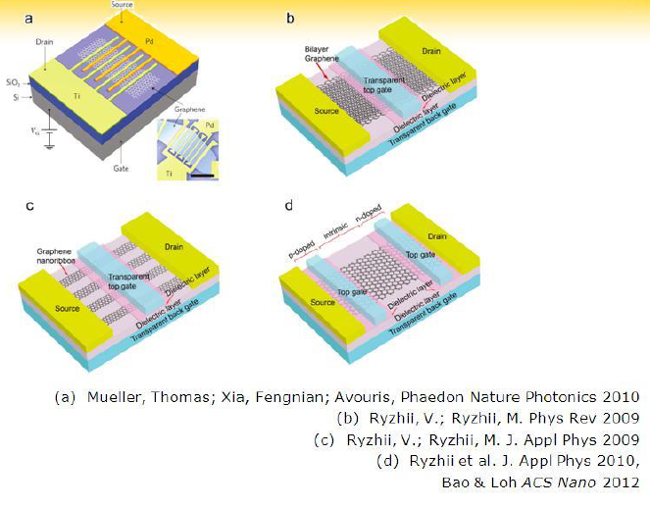
Typical photonic applications - Photodetector

Slide 15
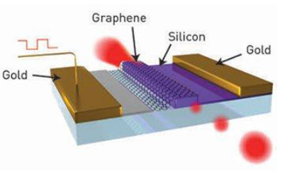
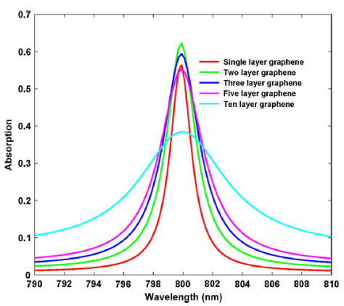
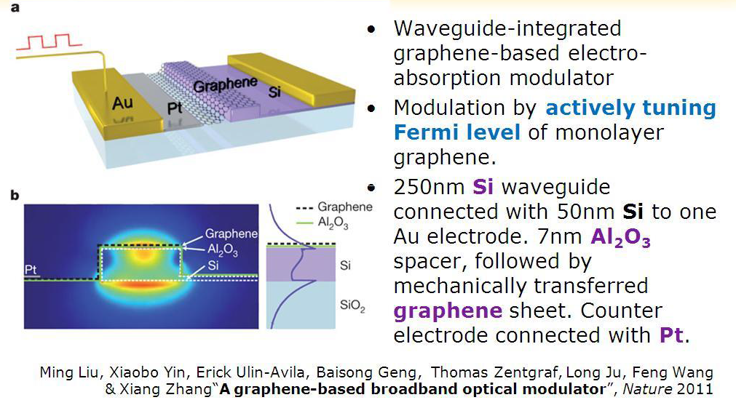
Typical photonic applications - Modulator

Slide 16
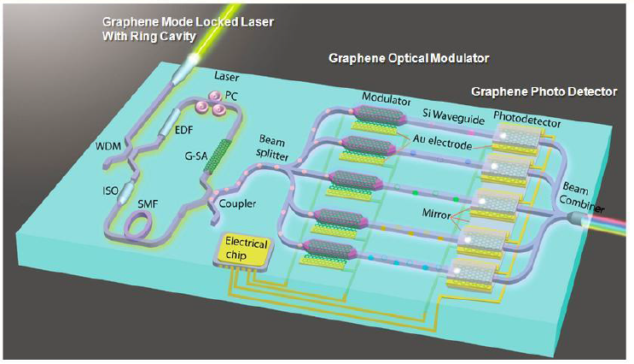
Typical photonic applications - Roadmap

Slide 17
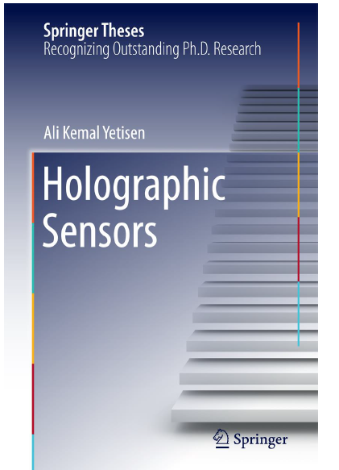
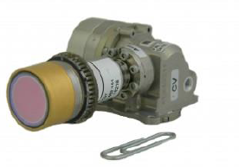
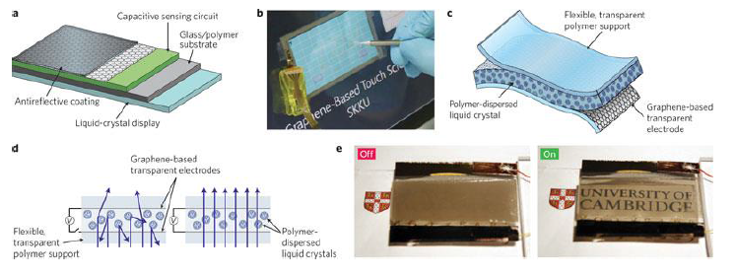
Other typical realizations
Cemag.us

Slide 18
Recommendations
Beyond CMOS
NANO-TEC project recommendations for R&T in nanotechnologies, 10 members, ICN2 Spain-VTT Technical R center Finland, TUD, Netherlands, Univ Lille Fr,…,edacentrum GmbH Gr
Relevant parameters ? power not speed, not new switch but smarter, limits of binary computing…
For all state variables - charge based or not, a better theoretical understanding of the underlying physics and material sciences is recommended
Nano affect not only performance, interconnects and architectures but also
and perhaps more importantly reliability and temperature stability

Slide 19
© AIRBUS Operations LTD. All rights reserved. Confidential and proprietary document. This document and all information contained herein is the sole property of AIRBUS Operations LTD, No intellectual property rights are granted by the delivery of this document or the disclosure of its content. This document shall not be reproduced or disclosed to a third party without the express written consent of AIRBUS Operations LTD. This document and its content shall not be used for any purpose other than that for which it is supplied. The statements made herein do not constitute an offer. They are based on the mentioned assumptions and are expressed in good faith. Where the supporting grounds for these statements are not shown, AIRBUS Operations LTD will be pleased to explain the basis thereof. AIRBUS, its logo, A300, A310, A318, A319, A320, A321, A330, A340, A350, A380, A400M are registered trademarks.
THANK YOU

